Slide 1


Introduction to Competitive Programming
Week 8: Problem Solving + Creativity
Notes:
https://join.slack.com/t/introductiont-c5a2137/shared_invite/zt-djtdwpqu-S_tju9SZhk2IKhcYICitCQ

Slide 2
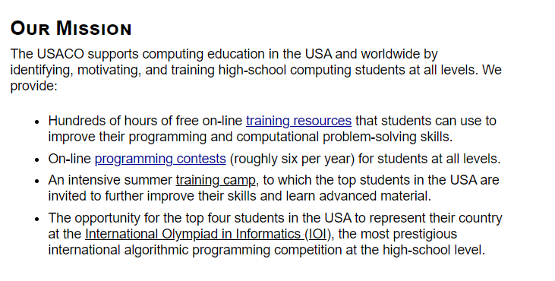
Introduction
USACO (USA Computing Olympiad)

Slide 3
Introduction
USACO (USA Computing Olympiad)
Creativity: thinking critically to solve problems you’ve never seen before

Slide 4
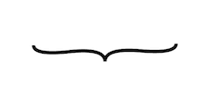
Introduction
USACO (USA Computing Olympiad)
Creativity: thinking critically to solve problems you’ve never seen before
Bronze: 0-1 algorithms/data structures, some creativity
Silver: 1-2 algorithms/data structures, some creativity
Gold: 1-3 algorithms/data structures, substantial creativity
Platinum: 2-3 algorithms/data structures, insane creativity

Slide 5
1.
Practicing Creativity Through Problem Solving

Slide 6
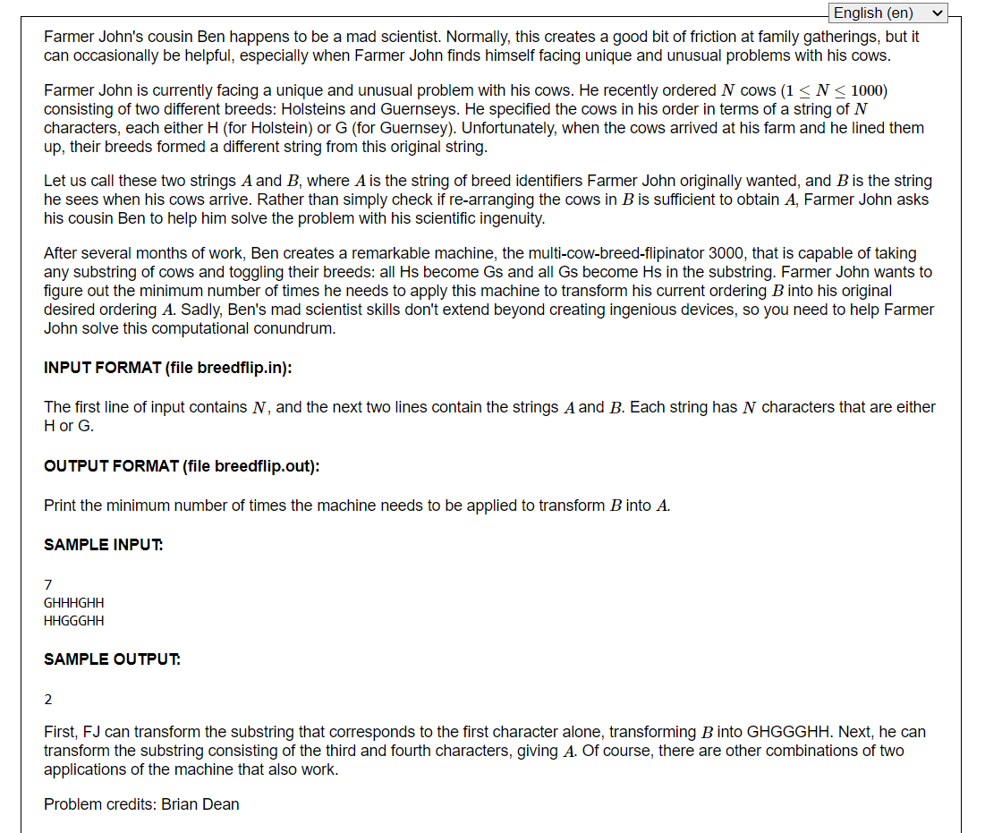
Bronze
Feb. 2020
#2

Slide 7
Bronze
Feb. 2020
#2
1 algorithm
Creativity

Slide 8
Aside: Files in Python/USACO
In USACO, input data is given in a file (input.txt)
Your program must write its output to a file (output.txt)
Python
input = open(“input.txt”)
data = input.readlines()
output = open(“output.txt”, “w”)
output.write(“2”)

Slide 9
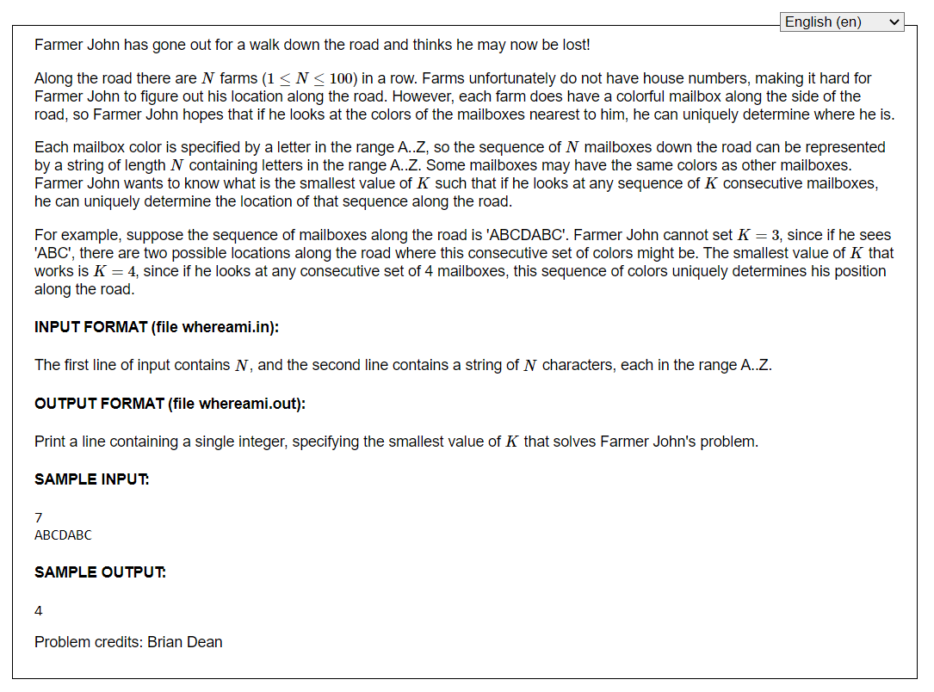
Bronze
Dec. 2019
#2

Slide 10
Bronze
Dec. 2019
#2
1 DS
Creativity

Slide 11
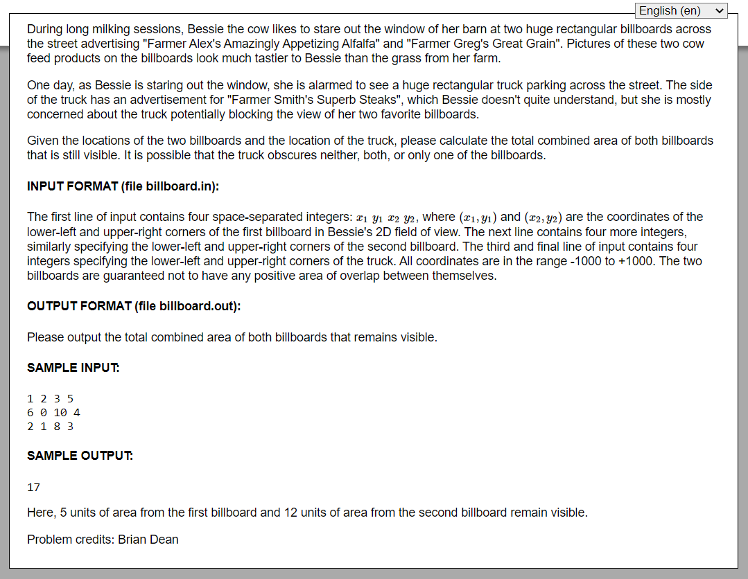
Bronze
Dec. 2017
#1

Slide 12
Bronze
Dec. 2017
#1
1 DS
Creativity

Slide 13
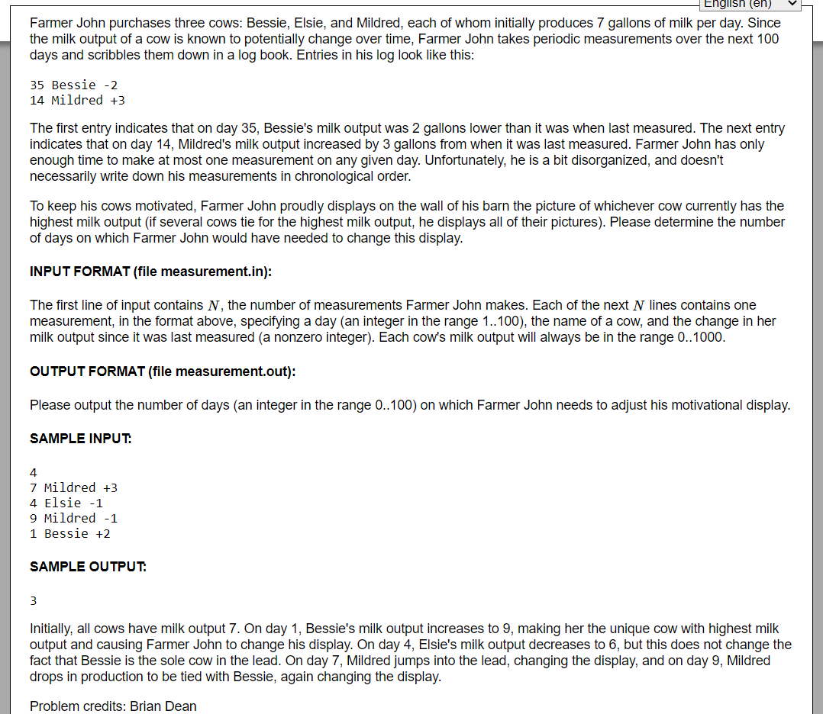
Bronze
Dec. 2017
#2

Slide 14
Bronze
Dec. 2017
#2
1 DS
Creativity

Slide 15
2.
Endnotes

Slide 16
Homework
Week 8: General Problem Solving
Collected (email me!)
Bug fixing, optimization, concerns
Highly encouraged
4-5 / week
Leetcode / USACO
Sign up, practice working with files

